Slide 1
Understanding Memory Leaks
• Topic: Understanding Memory Leaks
• Subtitle: Causes, Effects, and Detection

Slide 2
Introduction
Definition of Memory Leak:
A memory leak occurs when a program fails to release memory it has allocated, leading to wasted resources and potential performance issues.
Importance of Addressing Memory Leaks:
Memory leaks can degrade application performance over time and lead to system instability.

Slide 3

Causes of Memory Leaks
Improper memory management:
Forgetting to release allocated memory.
Incorrect use of pointers or references.
Circular references:
Objects referencing each other, preventing the garbage collector from reclaiming memory.

Slide 4

Effects of Memory Leaks
Performance degradation:
Increased memory usage over time.
Slower application response times.
System instability:
Crashes and freezes due to excessive memory consumption.

Slide 5
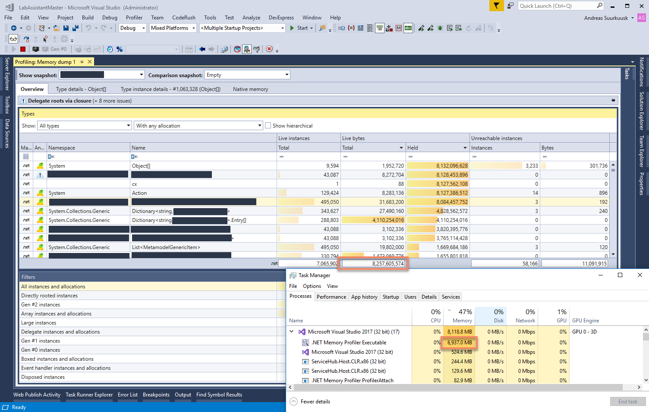
Detection of Memory Leaks
Tools for Memory Profiling:
Visual Studio Memory Profiler
.NET Memory Diagnostics
Symptoms:
Increased memory usage over time
Application crashes or freezes.

Slide 6
Summary
Recap of key points:
Memory leaks waste resources and degrade application performance.
Causes include improper memory management and circular references.
Detection is crucial for maintaining application stability.

Slide 7
Thank You
Hareesh Guvvala

